Slide 1
Biochemistry
Lec:2
Dr.Radhwan M. Asal
Bsc. Pharmacy
MSC ,PhD Clinical Biochemistry

Slide 2
ELECTRON TRANSPORT CHAIN
The electron transport chain is present in the inner mitochondrial membrane and is the final common pathway by which electrons derived from different fuels of the body flow to oxygen. Although the outer membrane contains special pores, making it freely permeable to most ions and small molecules, the inner mitochondrial membrane is a specialized structure that is impermeable to most small ions, including H,Na,K and small molecules such as ATP, ADP, pyruvate, and

Slide 3
other metabolites important to mitochondrial function. Specialized carriers or transport systems are required to move ions or molecules across this membrane.
Reactions of the electron transport chain
With the exception of coenzyme Q, all members of this chain are proteins. These may function as enzymes as is the case with the dehydrogenases, they may contain iron as part of an iron-sulfur center, they may be coordinated with a porphyrin ring as in the cytochromes, or they may contain copper, as does the cytochrome a +a3 complex.

Slide 4
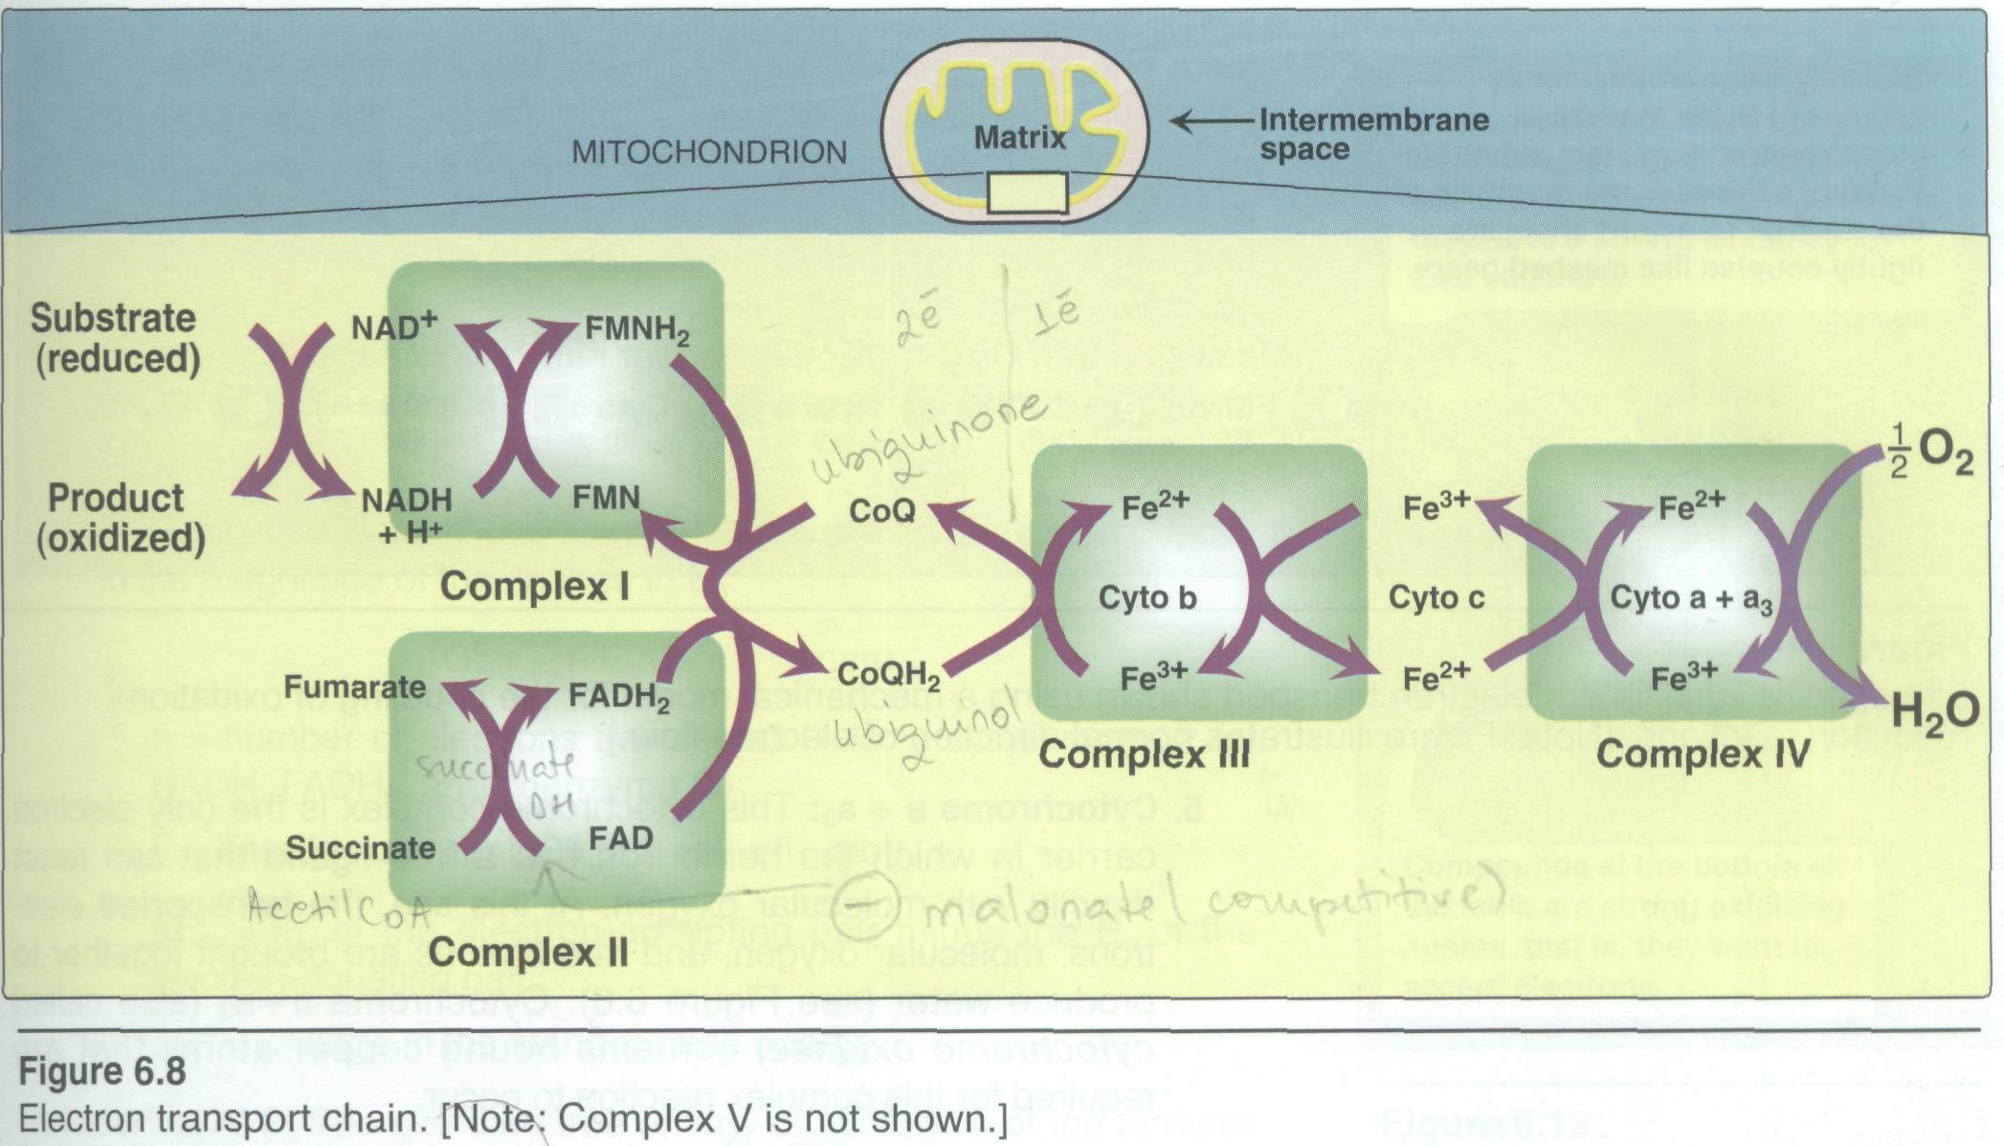

Slide 5
1.Formation of NADH:
NAD⁺ is reduced to NADH by dehydrogenases that remove two hydrogen atoms from their substrate. Both electrons but only one proton (that is a hydride ion, :H are transferred to the NAD⁺ forming NADH plus a free proton H+.
2. NADH dehydrogenase: The free proton plus the hydride ion carried by NADH are next transferred to NADH dehydrogenase, an enzyme complex (complex I) embedded in the inner mitochondrial membrane this……..

Slide 6
complex has a tightly bound molecule of flavin mononucleotide (FMN, a coenzyme structurally related to FAD) that accepts the two hydrogen atoms(2e-+2H+) becoming FMNH2. NADH dehydrogenase also contains several iron atoms paired with sulfur atoms to make iron-sulfur centers. These are necessary for the transfer of the hydrogen atoms to the next member of the chain, ubiquinone (known as coenzyme Q).
3. Coenzyme Q: Coenzyme Q is a quinone derivative with a long isoprenoid tail.it is also called ubiquinone because it is ubiquitous in biologic systems.

Slide 7
Coenzyme Q can accept hydrogen atoms both from FMNH2 produced by NADH dehydrogenase, and from FADH2 (Complex II), which is produced by succinate dehydrogenase and acyl CoA dehydrogenase .
4.Cytochromes: The remaining members of the electron transport chain are cytochromes. Each contains a heme group made of a porphyrin ring containing an atom of iron ,Unlike the heme groups of hemoglobin, the cytochrome iron atom is reversibly converted from its ferricFe+3 to its ferrous Fe+2 form. Electrons are passed along the chain from coenzyme Q to cytochromes b and c (Complex III and a + a3).

Slide 8
5. Cytochrome a +a3: This cytochrome complexs is the only electron carrier in which the heme iron has a free ligand that can react directly with molecular oxygen. At this site, the transported electrons, molecular oxygen, and free protons are brought together to produce water. Cytochrome a +a3 (also called cytochrome oxidase) contains bound copper atoms that are required for this complex reaction to occur.

Slide 9
6. Site-specific inhibitors: These compounds prevent the passage of electrons by binding to a component of the chain, blocking the oxidation/reduction reaction. Therefore, all electron carriers before the block are fully reduced, whereas those located after the block are oxidized. [Note: Because electron transport and oxidative phosphorylation are tightly coupled, site-specific inhibition of the electron transport chain also inhibits ATP synthesis.]

Slide 10
Release of free energy during electron transport
Redox pairs: Oxidation (loss of electrons) of one compound is always accompanied by reduction (gain of electrons) of a second substance. For example, shows the oxidation of NADH to NAD+ accompanied by the reduction of FAD to FADH2.Such oxidation-reduction reactions can be written as the sum of two half-reactions: an isolated oxidation reaction and a separate reduction reaction .

Slide 11
NAD+ and NADH form a redox pair, as do FAD and FADH2 .Redox pairs differ in their tendency to lose electrons. This tendency is a characteristic of a particular redox pair, and can be quantitatively specified by a constant, Eo (the standard reduction potential), with units in volts.

Slide 12
